Slide 1


PILAP
Coffee, Constitution and Conversation
Thursday June 11th, 2026

Slide 2



What can you do if you see blatant abuse of the law by a fellow citizen, or a company, or even a government official ?

Slide 3
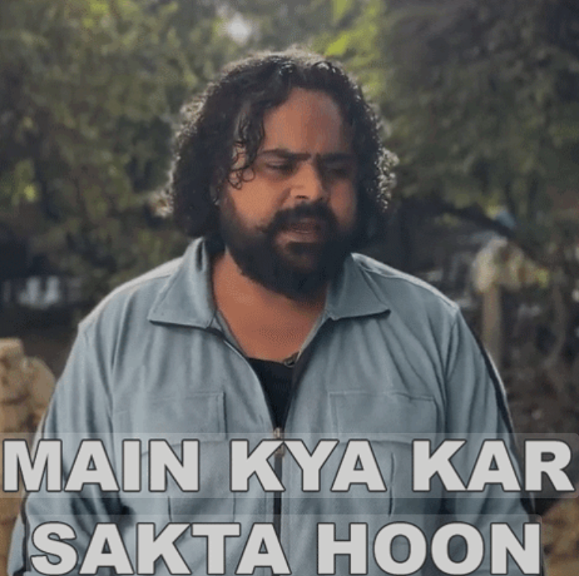


Slide 4

Become part of an active
“Civil Society Platform”

Slide 5

WIDESPREAD PUBLIC ISSUES
Poor healthcare
Unsafe drinking water
Poor access to justice
Unchecked child labour
Lack of good public schools
Widespread smog and pollution
Unregulated urban development
Total disregard for disablity rights
Freedom of expression being purged
…

Slide 6


PILAP
PILAP
PILAP
You need a Civil Rights Organization

Slide 7



Civil Rights Organizations
In most countries their exist ’apolitical’ ‘non-profit’ organizations which helps civil society fight for their rights.
American Civil Liberties Union (ACLU), USA
National Council for Civil Liberties (NCCL), UK
People’s Union for Civil Liberties (PUCL), India
106
92
50

Slide 8

THE PUBLIC INTEREST LAW ASSOCIATION OF PAKISTAN
PILAP is an independent, non-political, and not-for-profit organization.
It is dedicated to protecting and defending constitutional rights of all Pakistanis and holding those in power accountable

Slide 9

In Pakistan, a group of concerned citizens got together in 2011 and founded the Public Interest Law Association
of Pakistan
“A Pakistan where law protects all and rights are not only guaranteed but also practiced”
not only guaranteed but also practiced
VISION

Slide 10
PILAP FOUNDING MEMBERS
Aftab Nabi
Kazim Hassan
Khalid Aziz Mirza
Mohammad Akmal Wasim
Nasim Beg
Nasira Iqbal
Nasir Aslam Zahid
Salima Hashmi
Ahmad Rafay Alam
Amjad Waheed
(FOUNDER)
Kemal Shoaib (Late)

Slide 11


PILAP is a platform dedicated on BRIDGING THE GAP between constitutional guarantees and the
daily realities faced by citizens.
RIGHT TO LIFE
RIGHT TO LIBERTY
RIGHT TO FAIR TRIAL
RIGHT TO DIGNITY
RIGHT TO PRIVACY
RIGHT TO ASSEMBLY
EQUAL BEFORE THE LAW
FREEDOM OF MOVEMENT
FREEDOM OF ASSOCIATION
FREEDOM OF TRADE
FREEDOM OF SPEECH
FREEDOM OF RELIGION
FREEDOM OF EDUCATION
FREEDOM OF PROPERTY
NO FORCED LABOUR
NO CHILD LABOUR
NO UNFAIR TRIAL
NO PUNISHMENT TWICE
NO FORCED TAX BY OTHER RELIGION
NO DISCRIMINATION

Slide 12
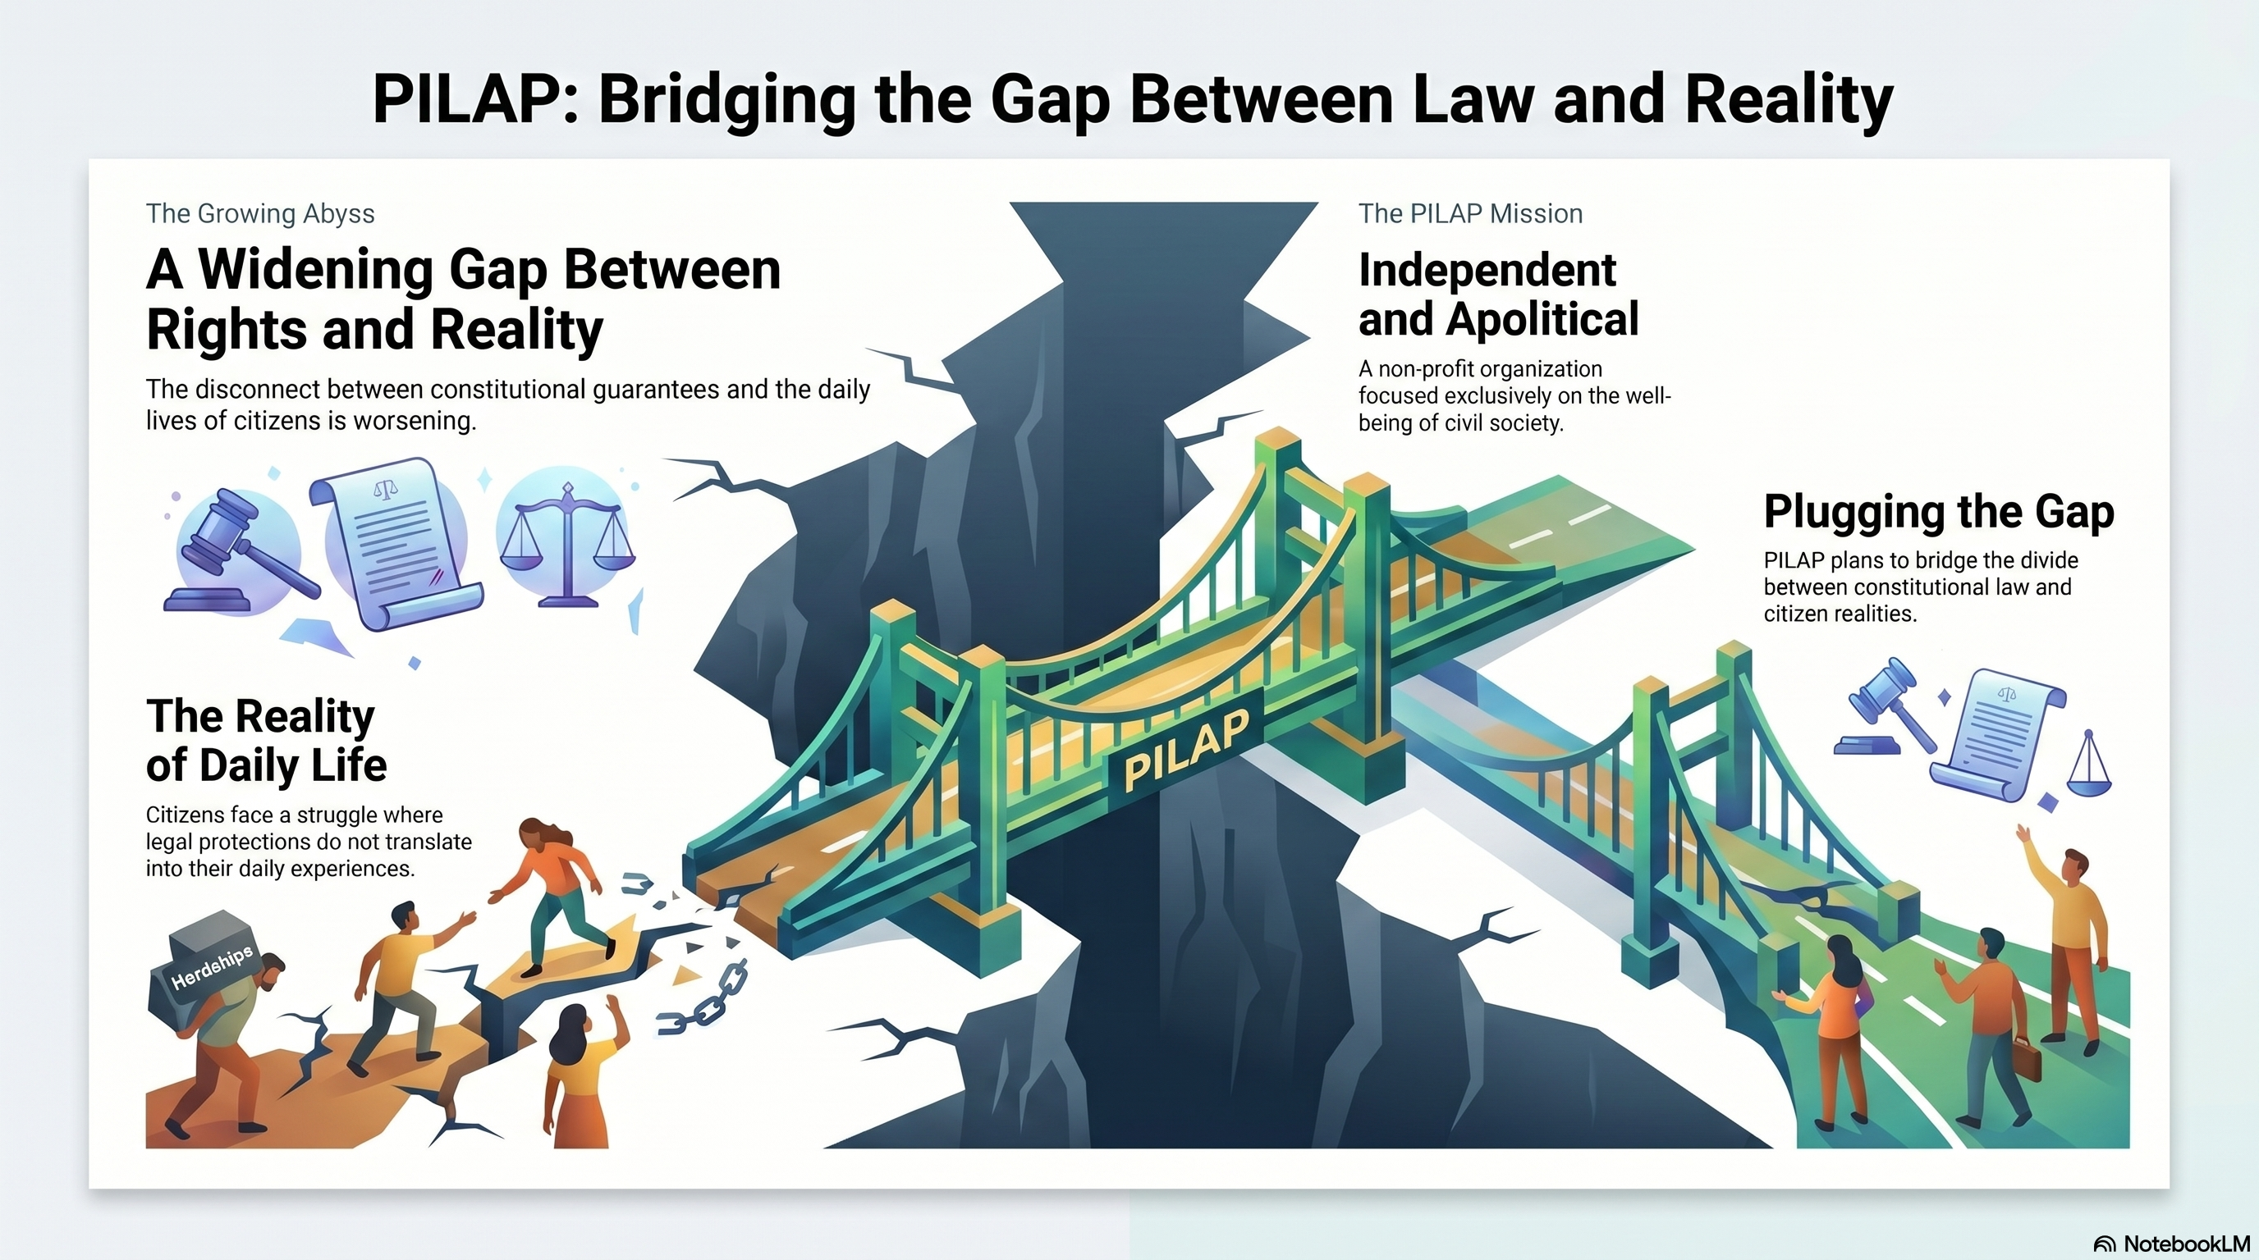

Slide 13
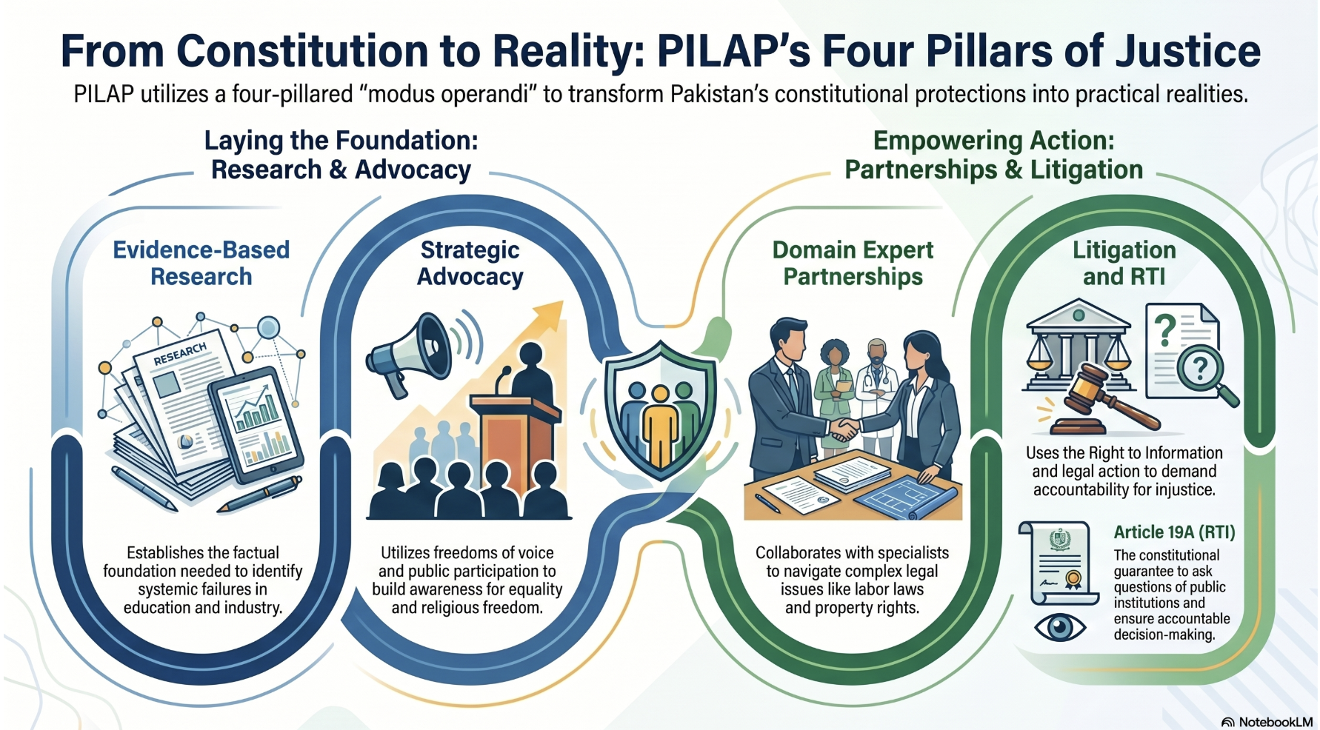


Slide 14
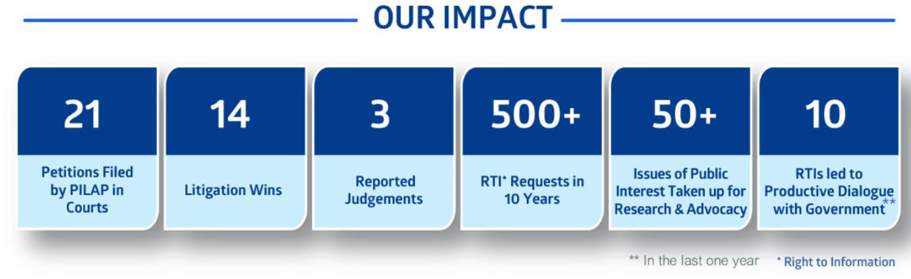
We are only 14 years old. We have a network of only 93 Citizens Assembly Members and
another 60 active friend circle. Employs only 3 staff attorney/researcher/finance.

Slide 15


Slide 16
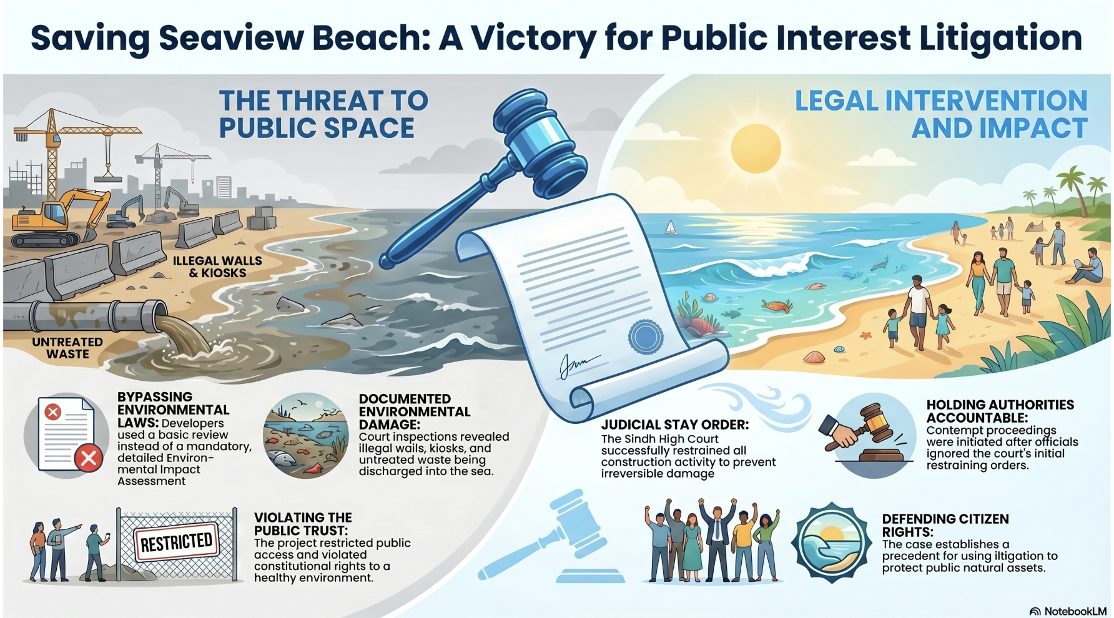


Slide 17
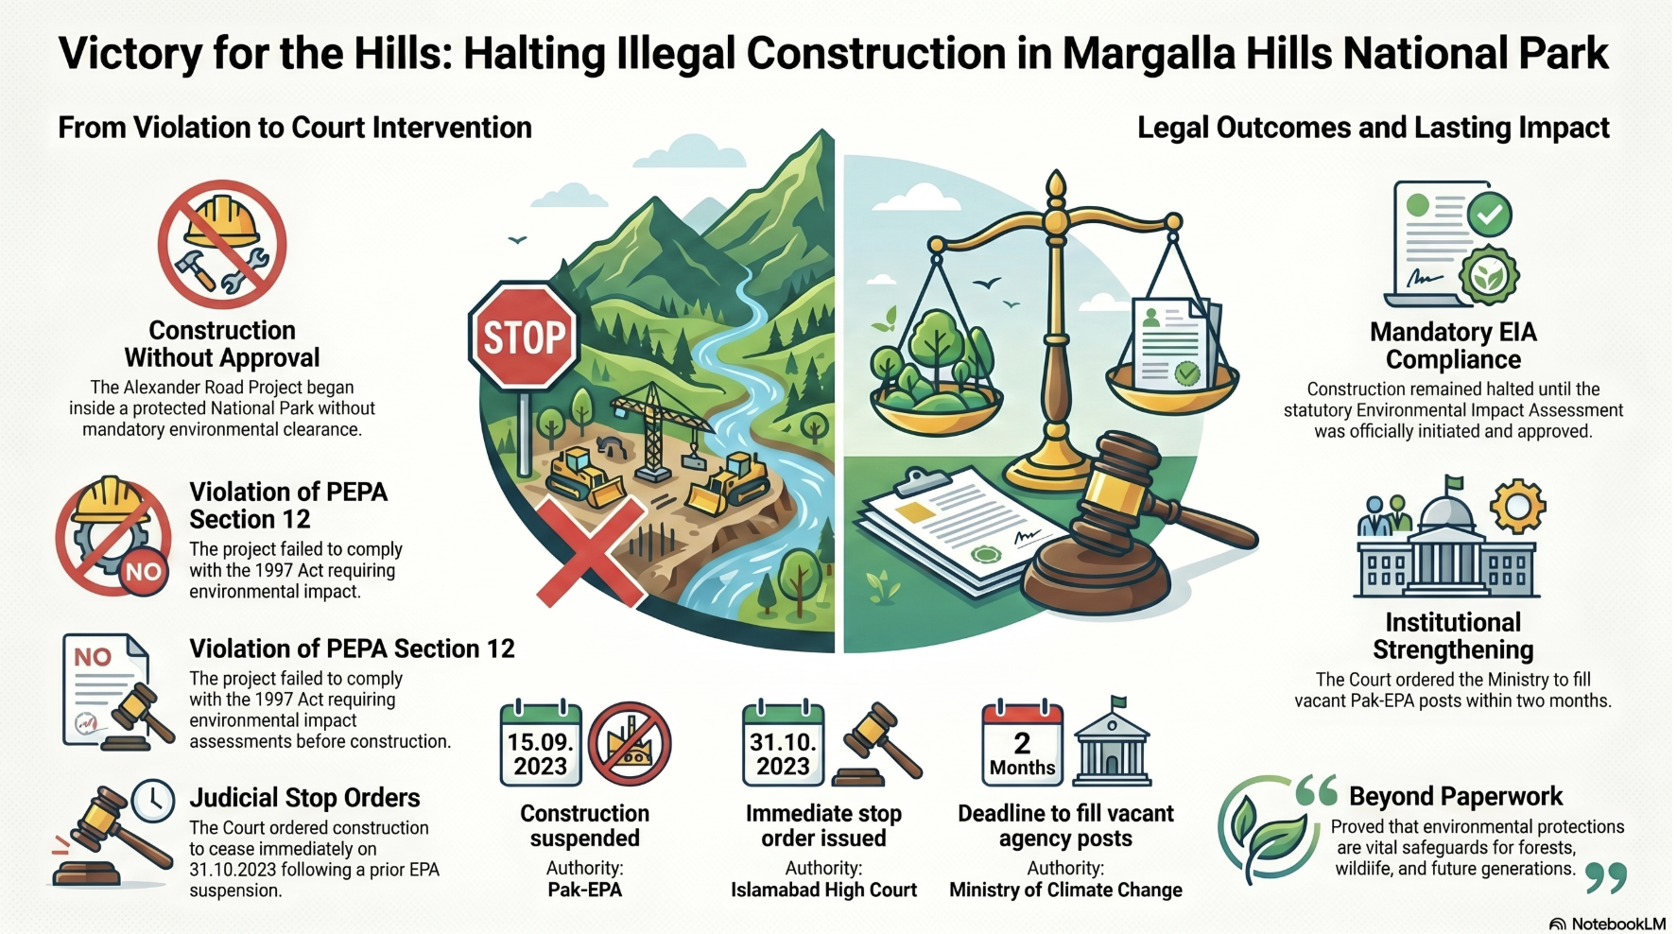


Slide 18
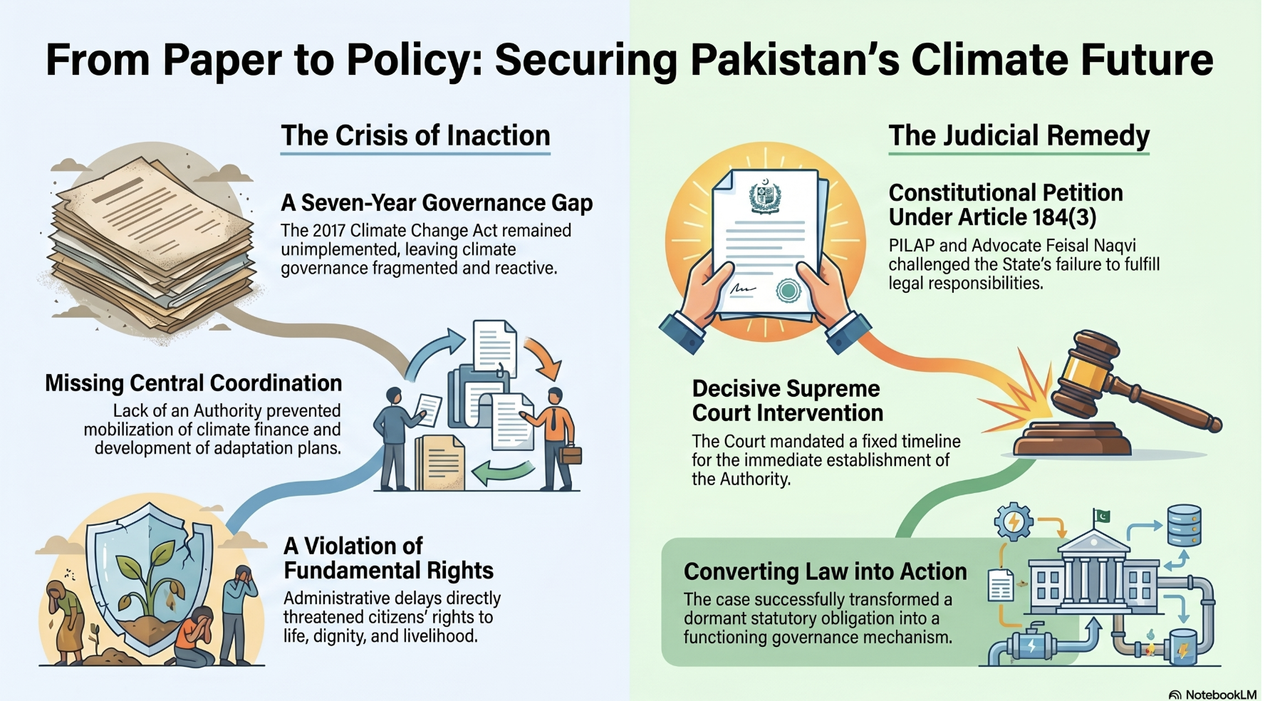


Slide 19
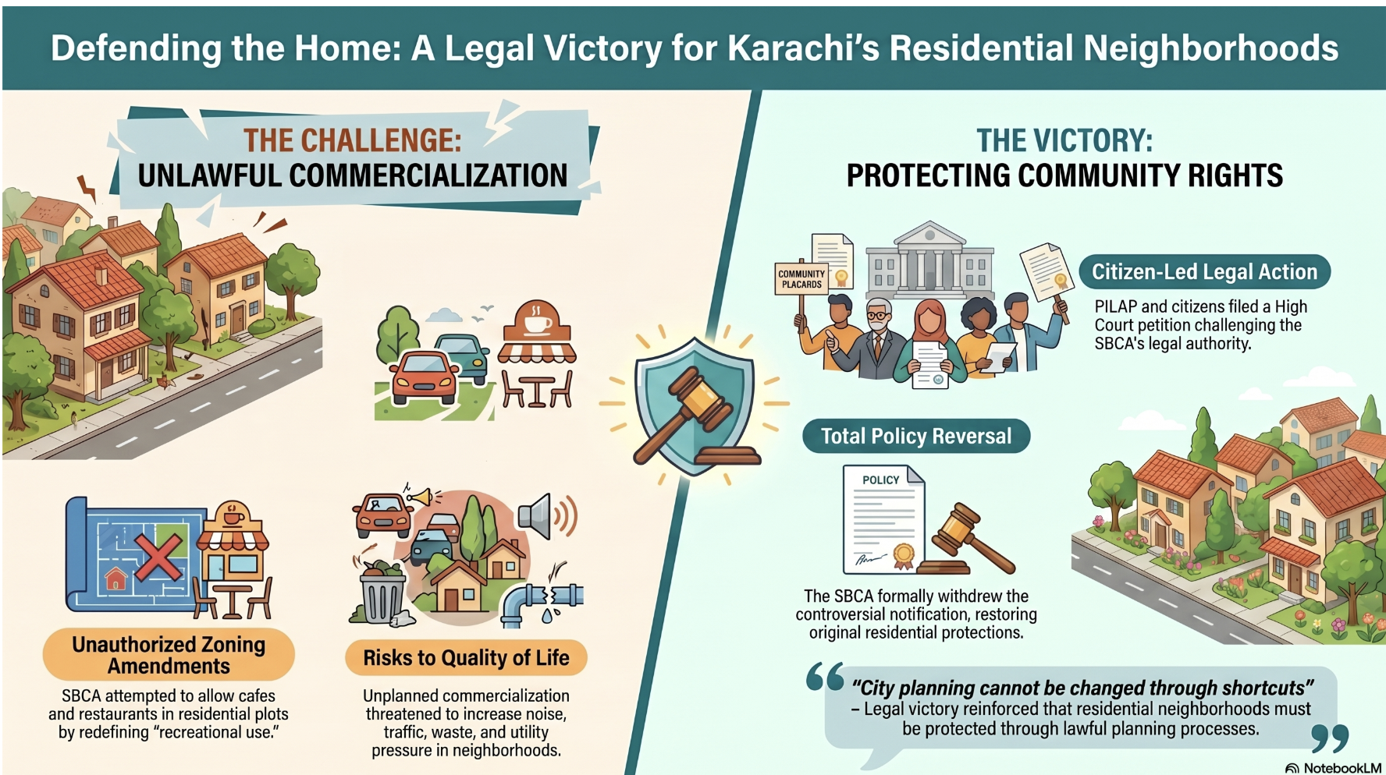


Slide 20



Slide 21
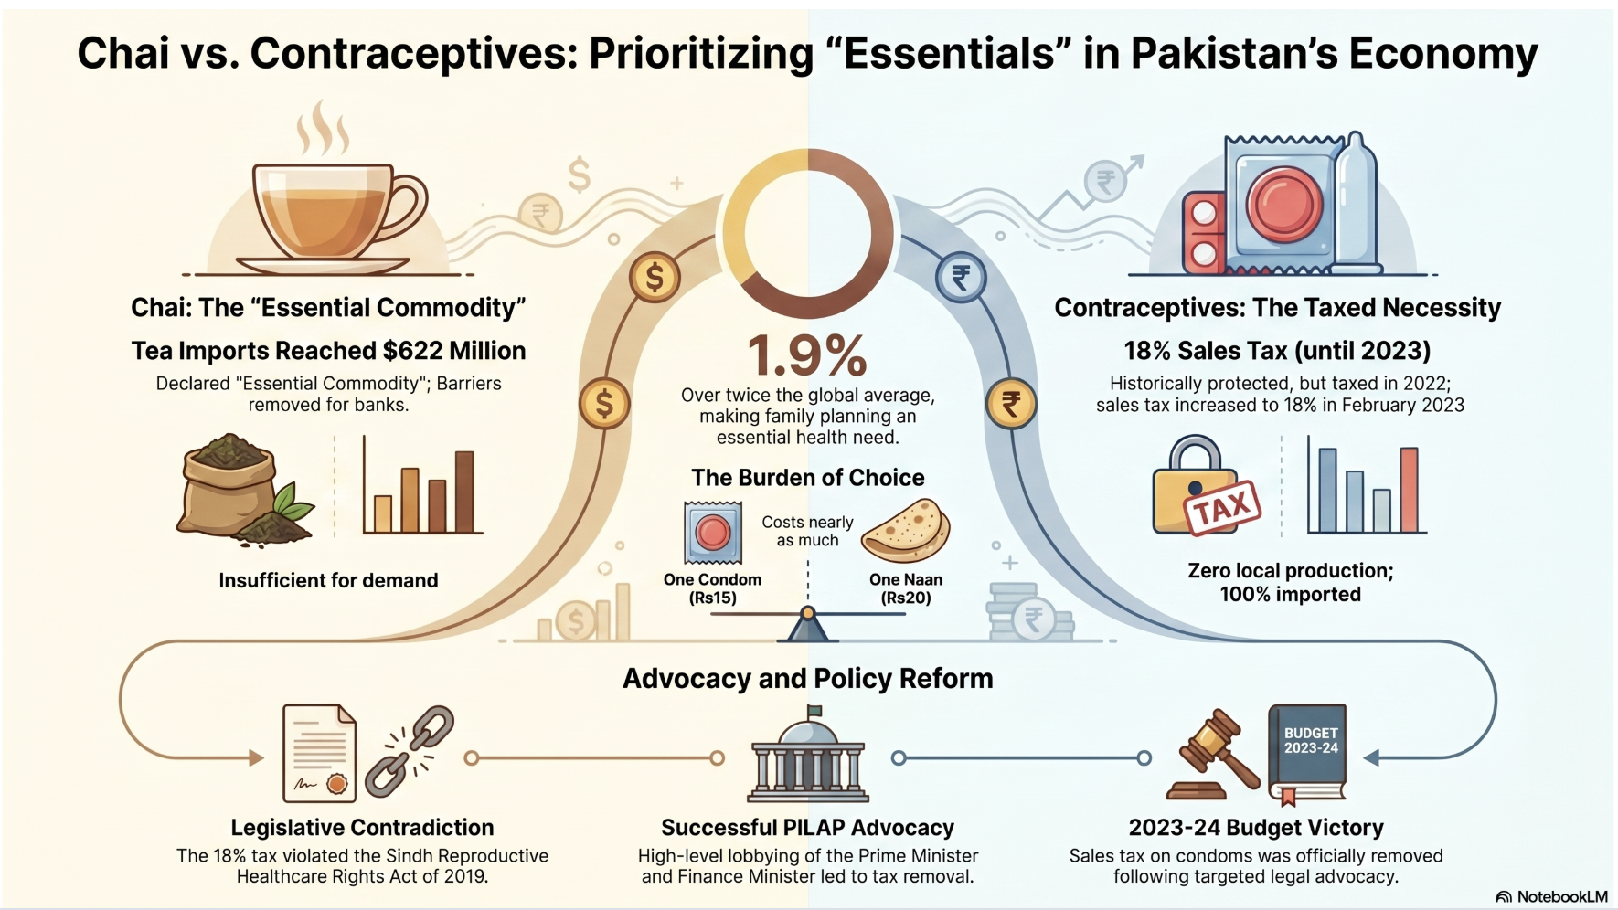


Slide 22
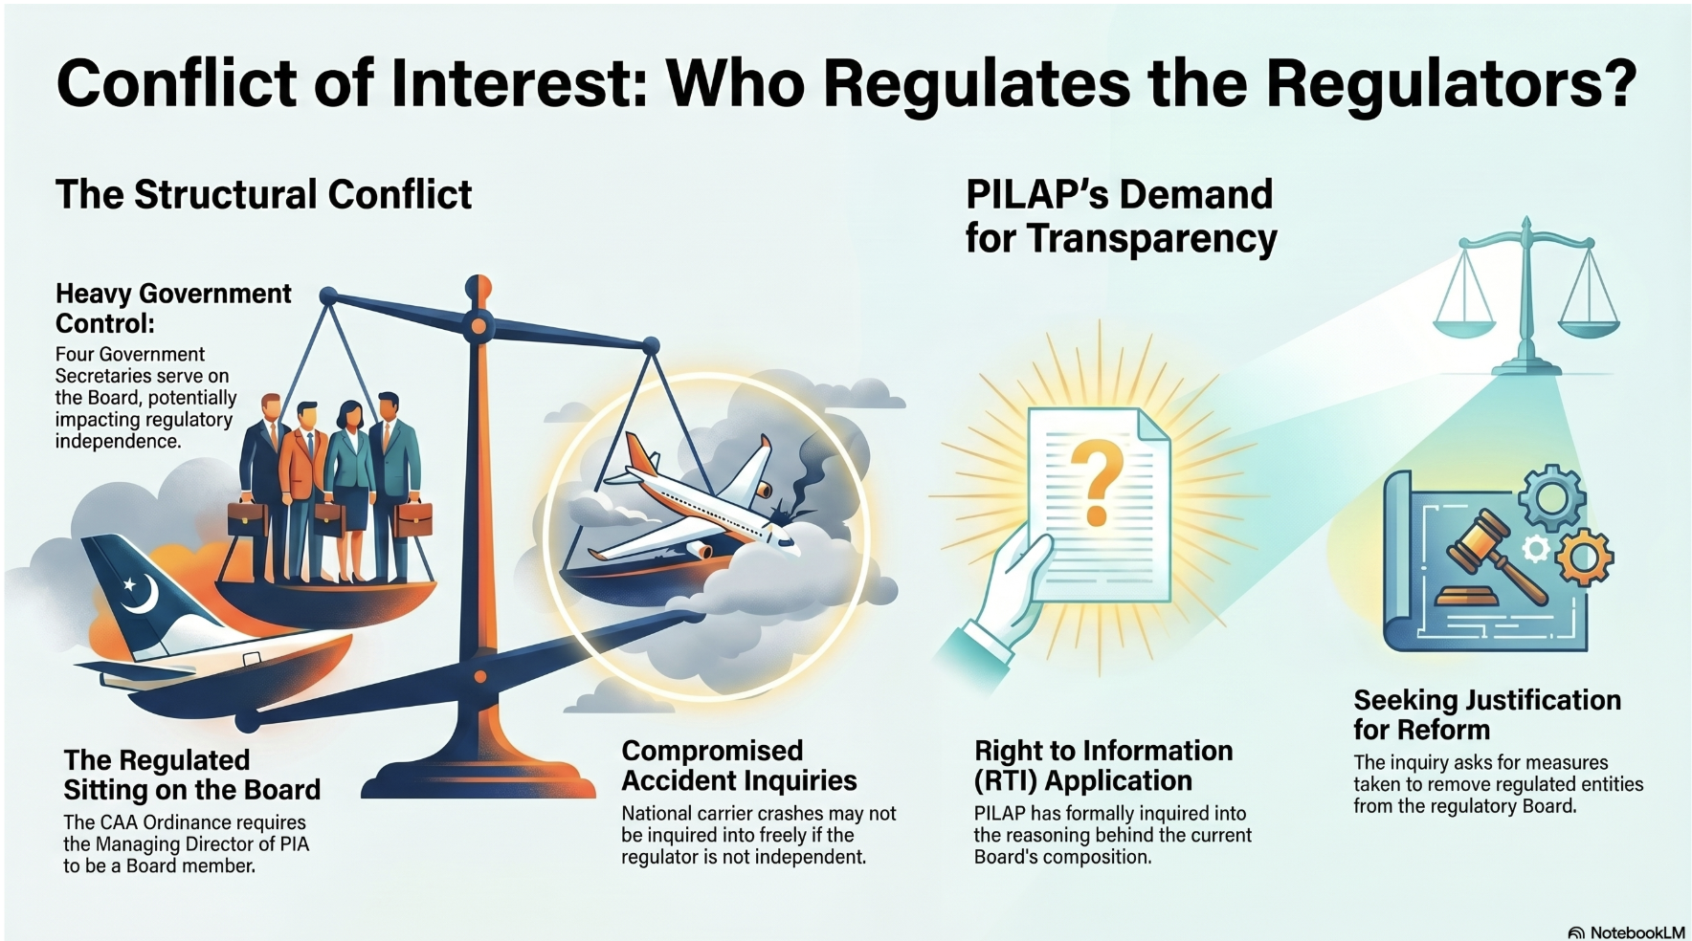


Slide 23

Major Re-vamping
Influx of Donor Funds
Hiring a full team, incl. Exec Dir.
Created a 3-year Vision/Strategies

Slide 24

VISION
2028

Slide 25


A Pakistan where law protects all and rights are not only guaranteed but also practiced.
To promote and protect constitutional rights for all Pakistanis.

Slide 26
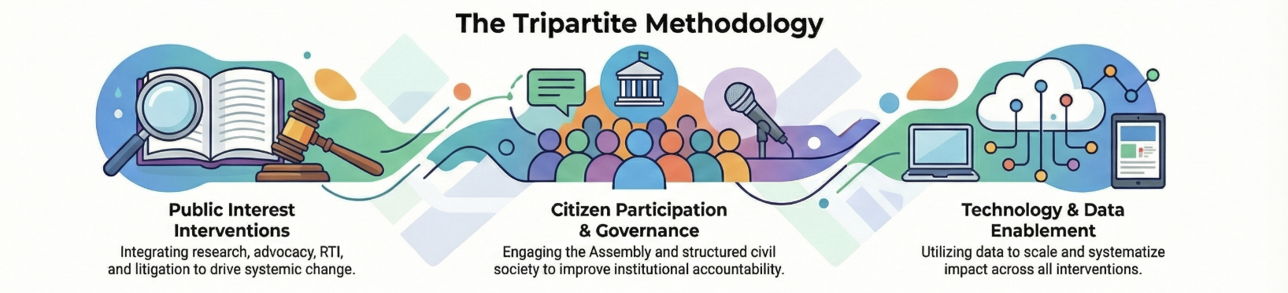


Slide 27

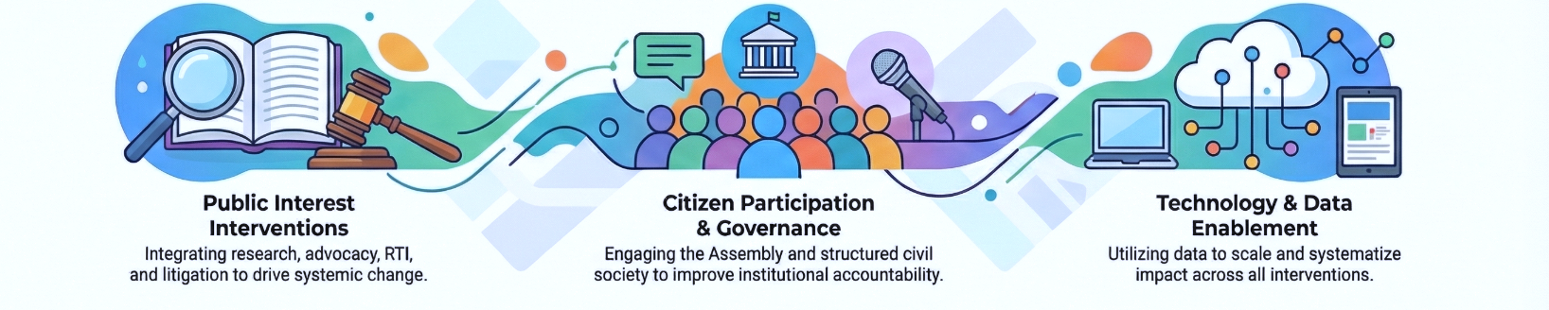


Slide 28

Digital
Safeguarding Pakistan’s Digital Future
Ensuring Quality Voice Calls & Internet Access
Karachi Coastal Regeneration Strategy
Digital Revolution in Women Inheritence Rights
Securing Sanitation Worker’s Dignity
Ensuring Juvenile Rights of Prisoners
Protecting Children from Cyber Preditors
Thelessemia Free Pakistan
Increasing Access to Justice
Focusing on Unimplemented PIL orders
Reforming Pakistan’s Education System
Strategies
Water
Women
Human
Children
Health
Judicial
Education

Slide 29
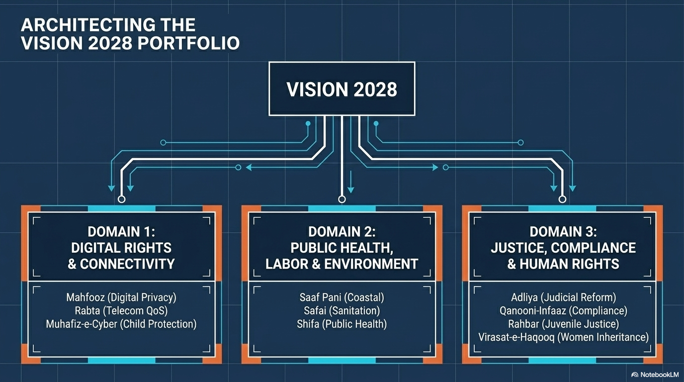





Slide 30



Slide 31



Collaboration

Slide 32
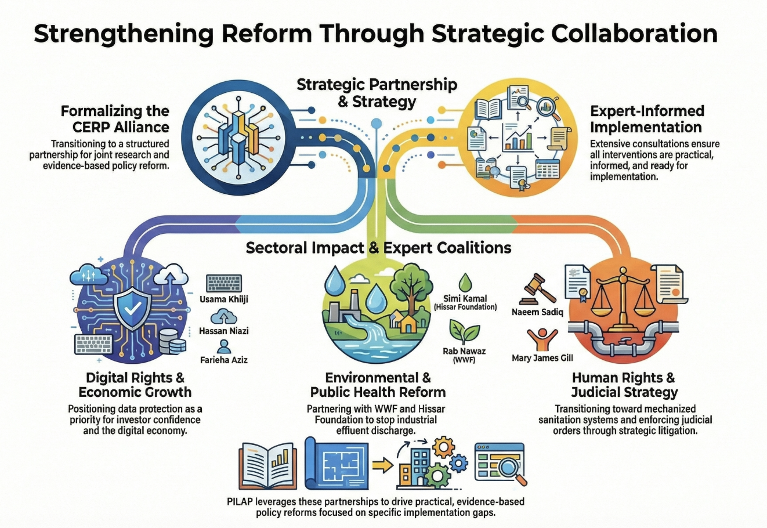

Slide 35
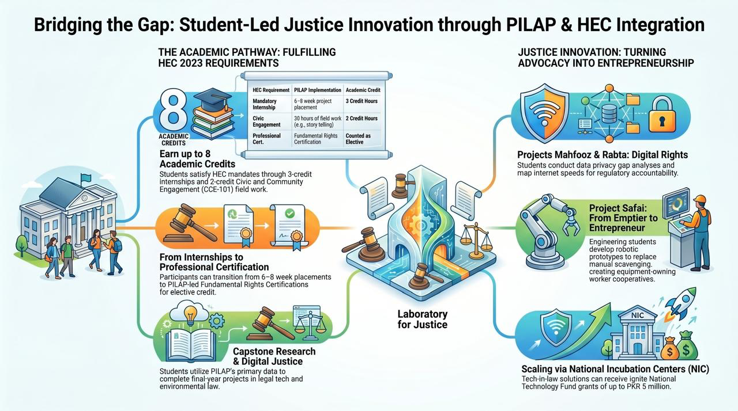

Slide 36
Digital
Safeguarding Pakistan’s Digital Future
Ensuring Digital Access and Transparency
Karachi Coastal Regeneration Strategy
Digital Revolution in Women Inheritence Rights
Securing Sanitation Worker’s Dignity
Protecting Pakistan’s Youth, Ensuring Justice
Protecting Children from Cyber Preditors
Thelessemia Free Pakistan
Bridging the Judicial Implementation Gap
Focusing on Unimplemented PIL orders
Reforming Pakistan’s Education System
Strategies
Water
Karachi Coastal Regeneration Strategy
Women
Human
Children
Education

Slide 37

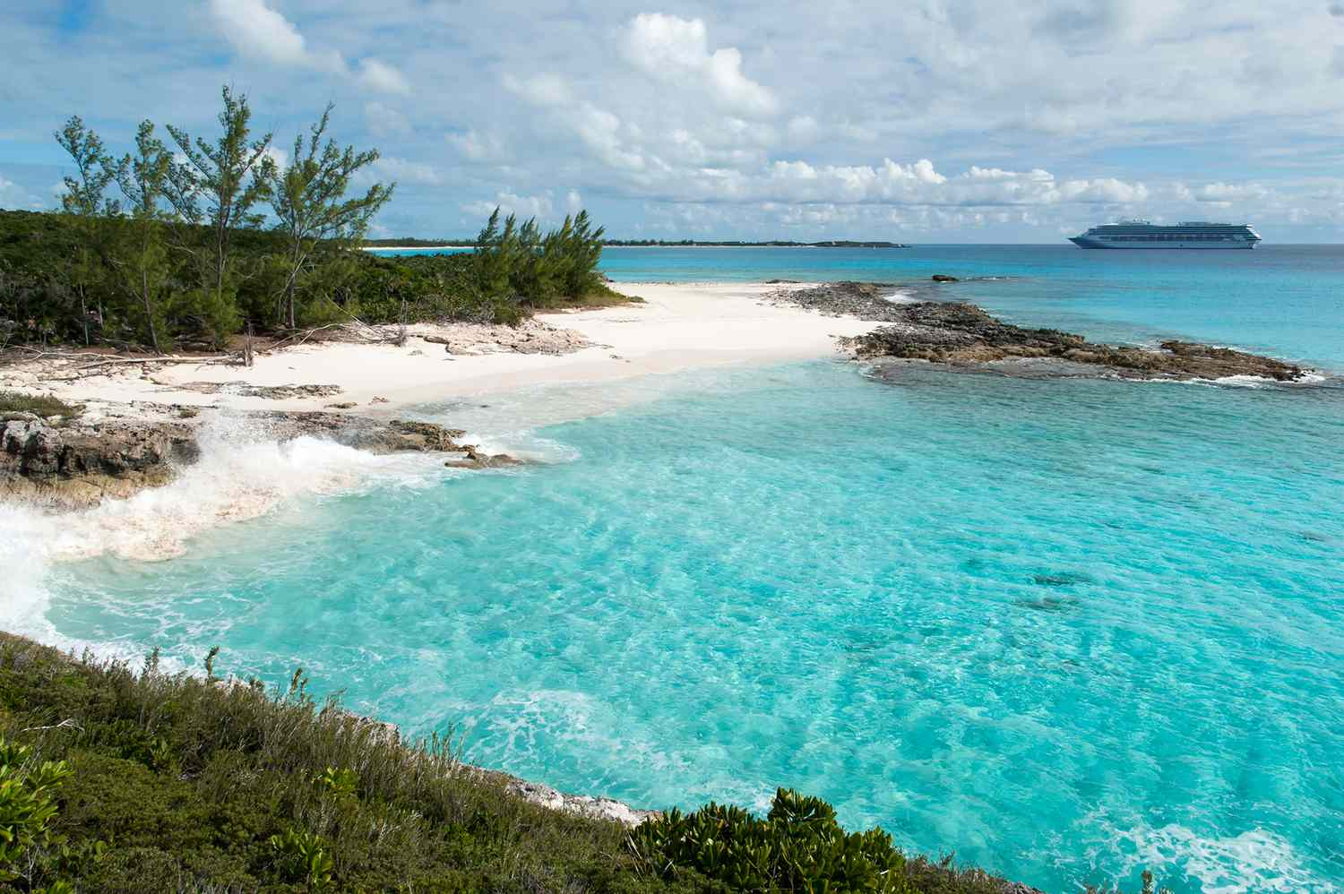
Project Saaf Pani:
Karachi Coastal Regeneration Strategy

Slide 38
Project Saaf Pani:
Karachi Coastal Regeneration Strategy
Project Saaf Pani is an ambitious initiative designed to restore Karachi’s coastal ecosystem through community-led oversight and modern technology.
The strategy emphasizes hybrid governance, utilizing local "Coastal Watch" teams and a "Digital Toxicity Map" to hold industrial polluters accountable via real-time data and legal action.

Slide 39
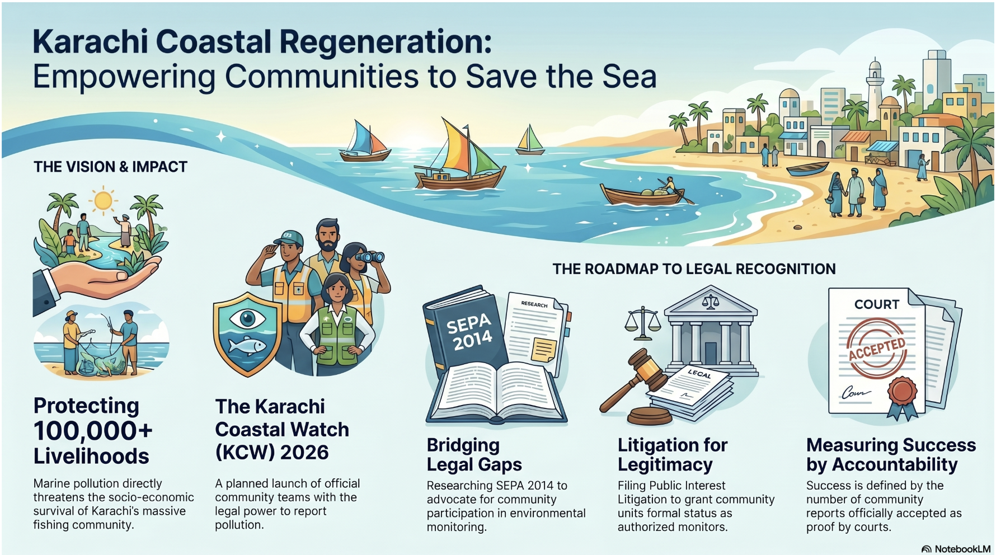

Slide 40
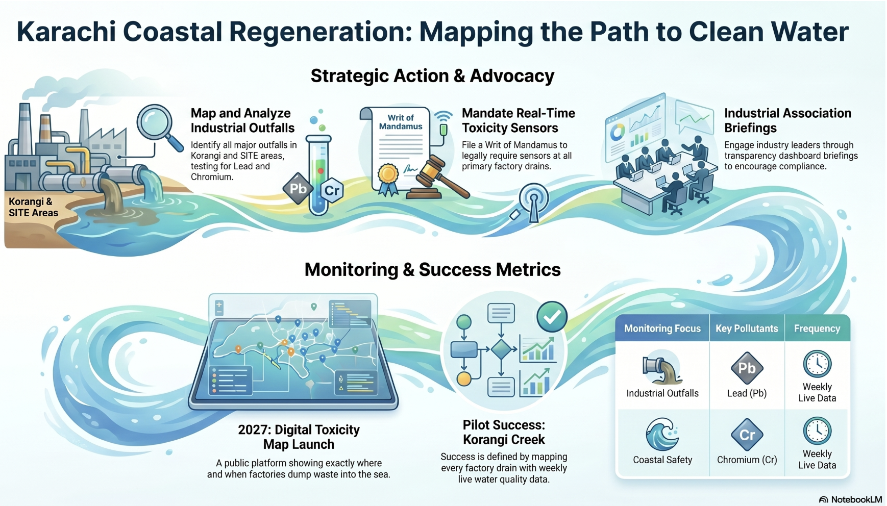


Slide 41
Project Saaf Pani:
Karachi Coastal Regeneration Strategy
Project Saaf Pani is an ambitious initiative designed to restore Karachi’s coastal ecosystem through community-led oversight and modern technology.
The strategy emphasizes hybrid governance, utilizing local "Coastal Watch" teams and a "Digital Toxicity Map" to hold industrial polluters accountable via real-time data and legal action.
To address contamination, the plan proposes nature-based solutions, such as using seaweed for bioremediation, which simultaneously cleans the water and creates economic opportunities for fishing families.

Slide 42
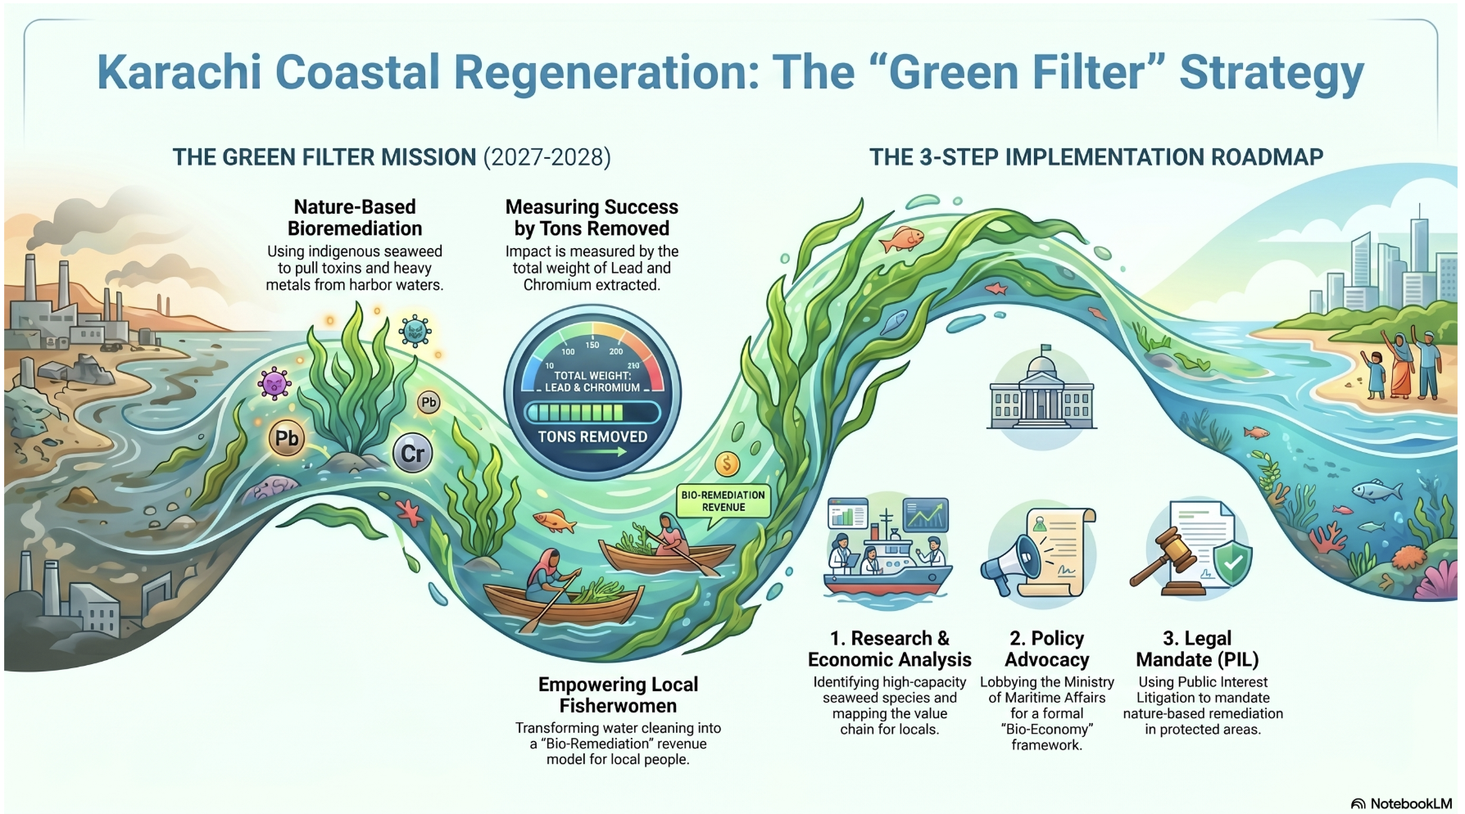

Slide 43
Project Saaf Pani:
Karachi Coastal Regeneration Strategy
Project Saaf Pani is an ambitious initiative designed to restore Karachi’s coastal ecosystem through community-led oversight and modern technology.
The strategy emphasizes hybrid governance, utilizing local "Coastal Watch" teams and a "Digital Toxicity Map" to hold industrial polluters accountable via real-time data and legal action.
To address contamination, the plan proposes nature-based solutions, such as using seaweed for bioremediation, which simultaneously cleans the water and creates economic opportunities for fishing families.
By filing Public Interest Litigation and transparency requests, the project aims to mandate the installation of waste treatment plants across industrial zones.

Slide 44
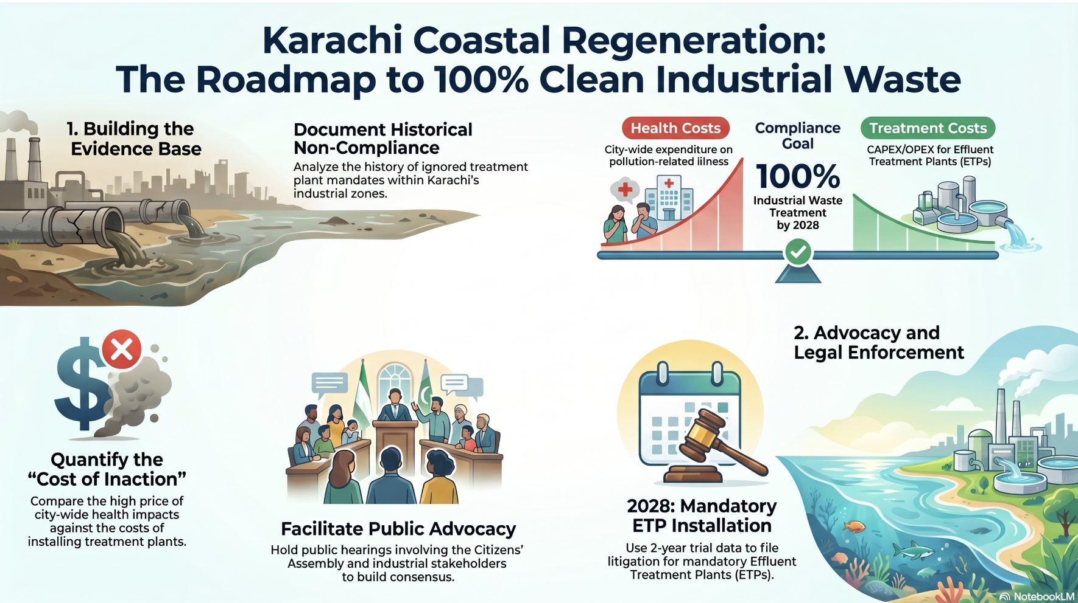

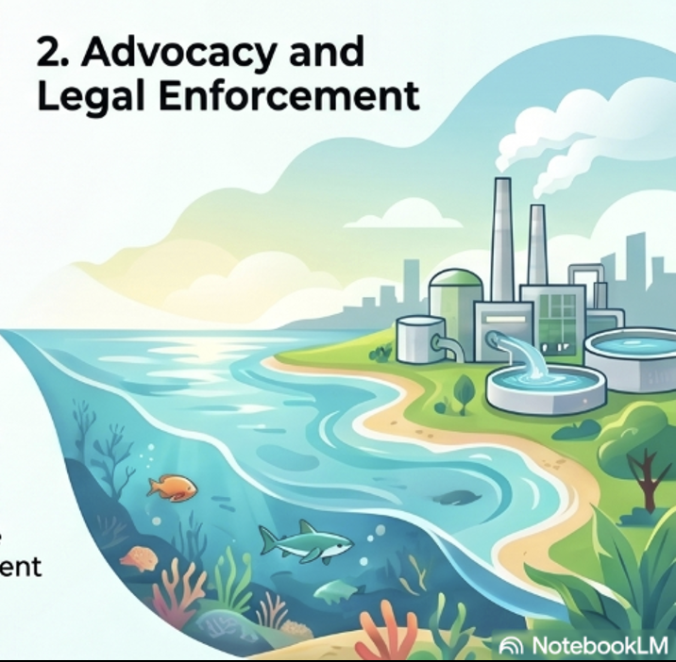

Slide 45
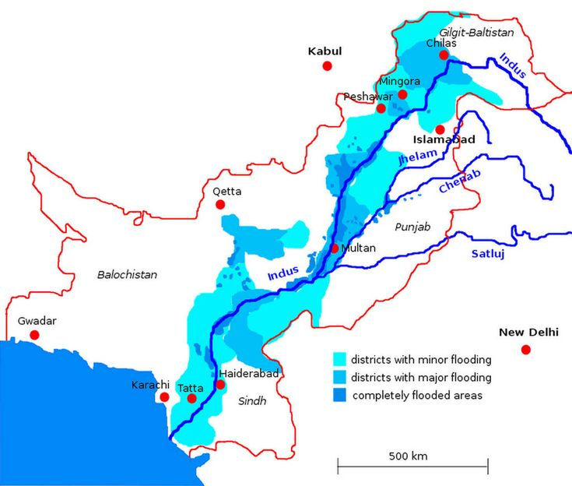


Slide 46


Slide 47
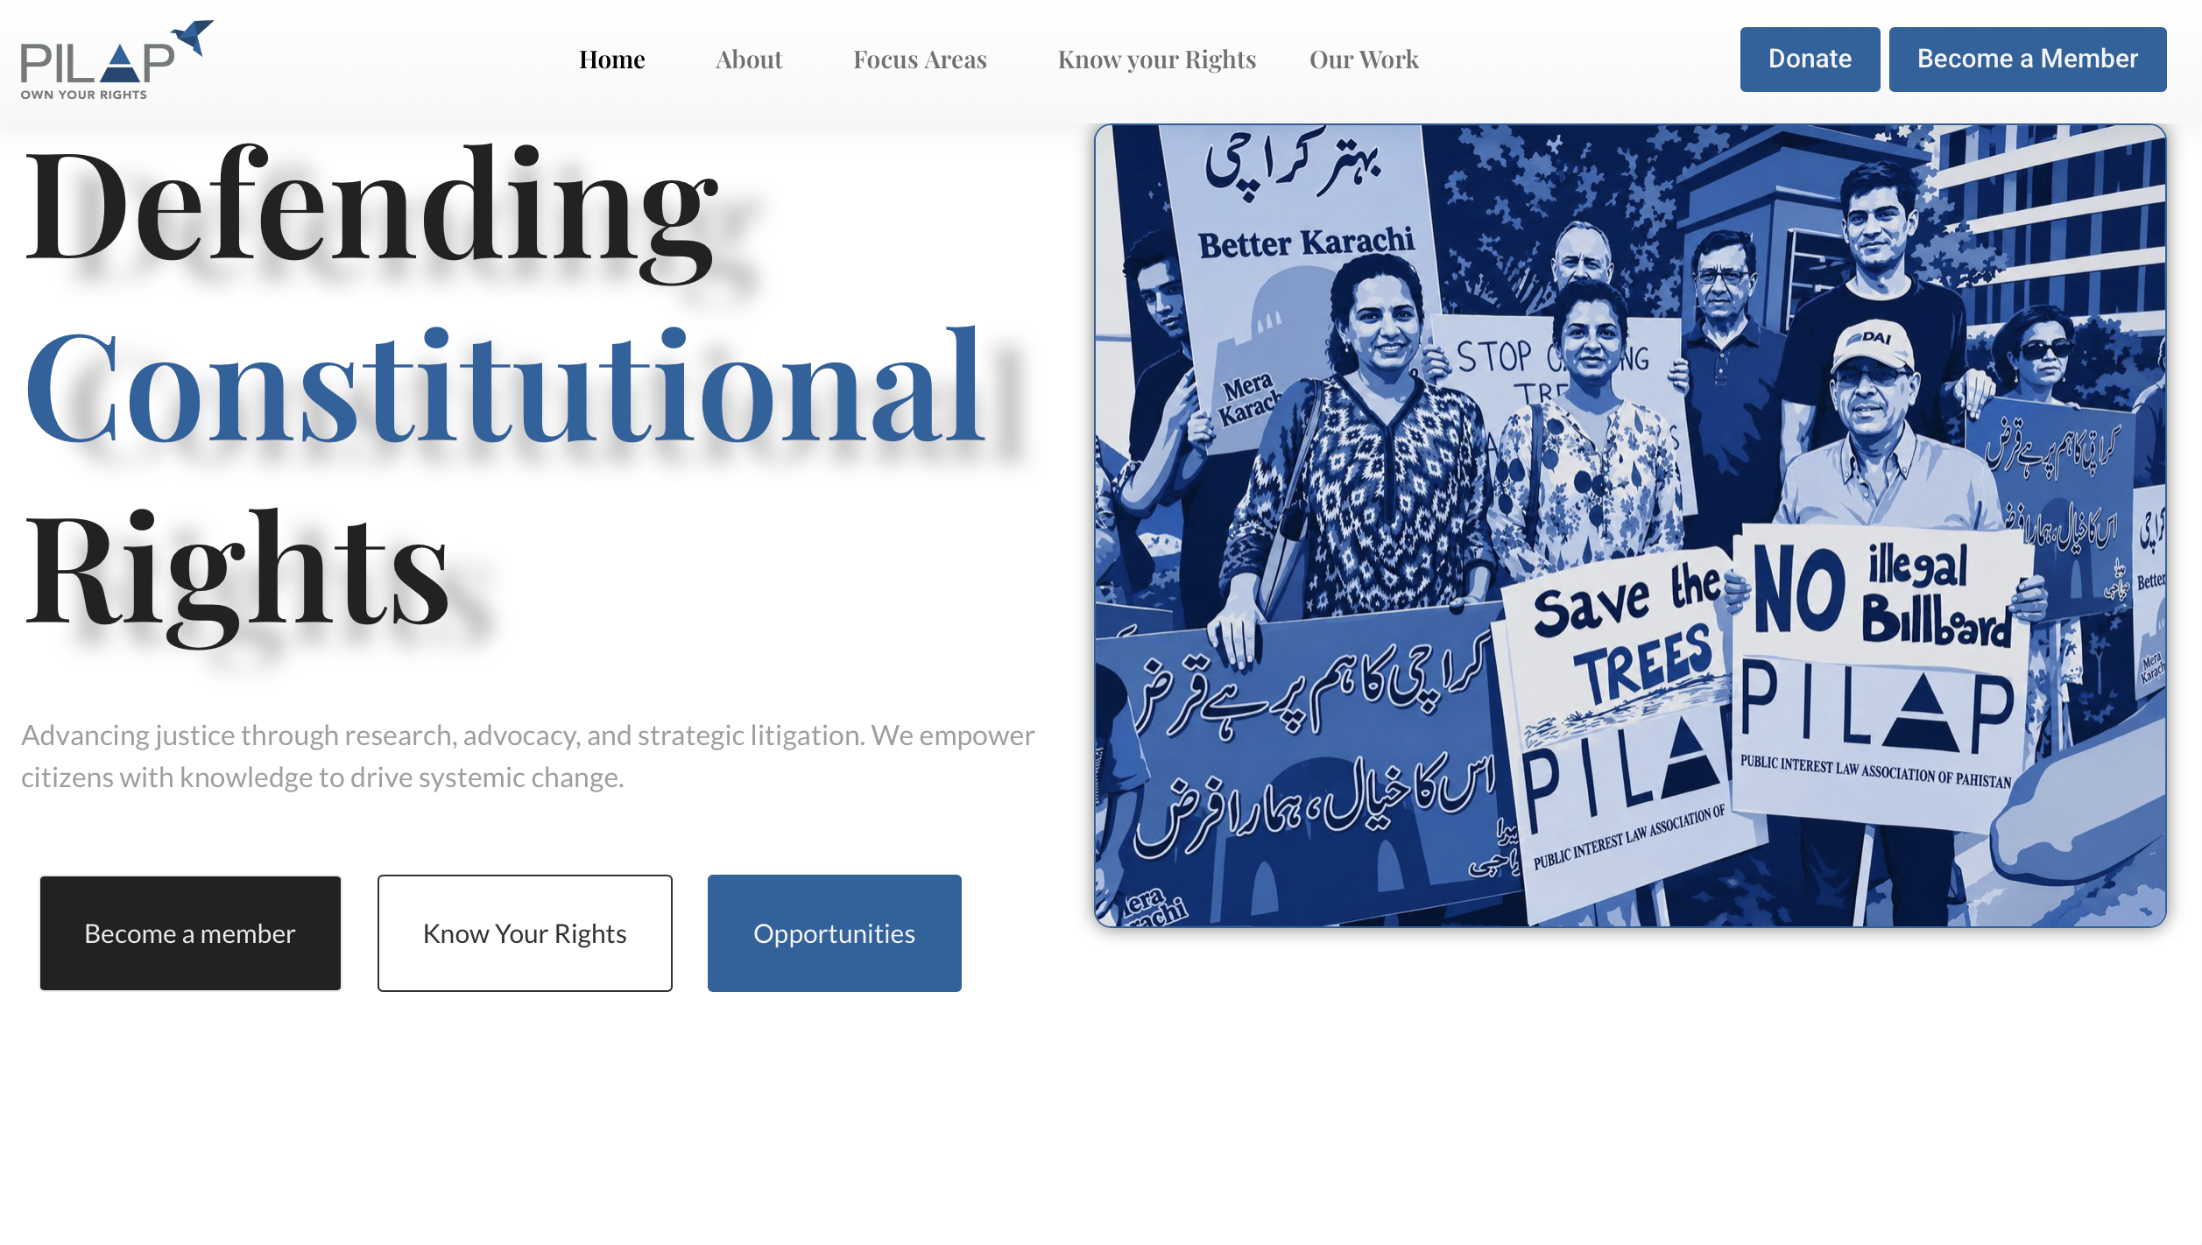
Website: https://pilap.pk

Slide 48

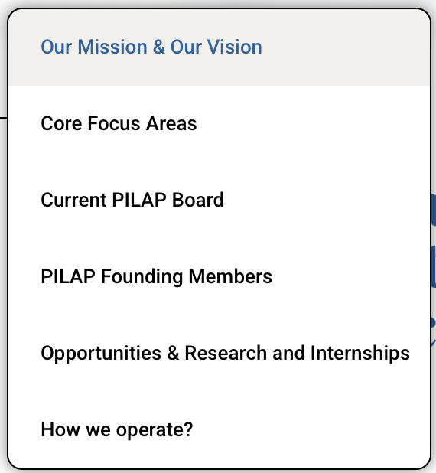
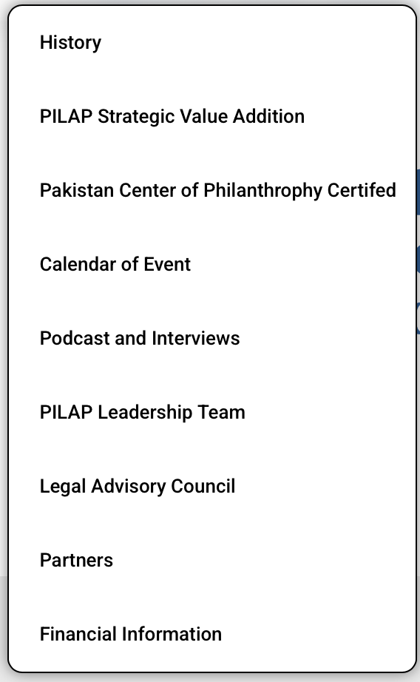
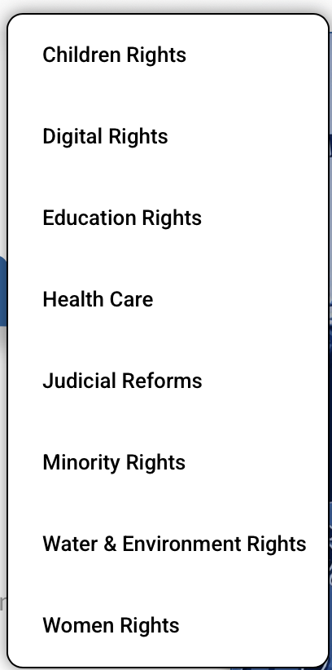

Slide 49
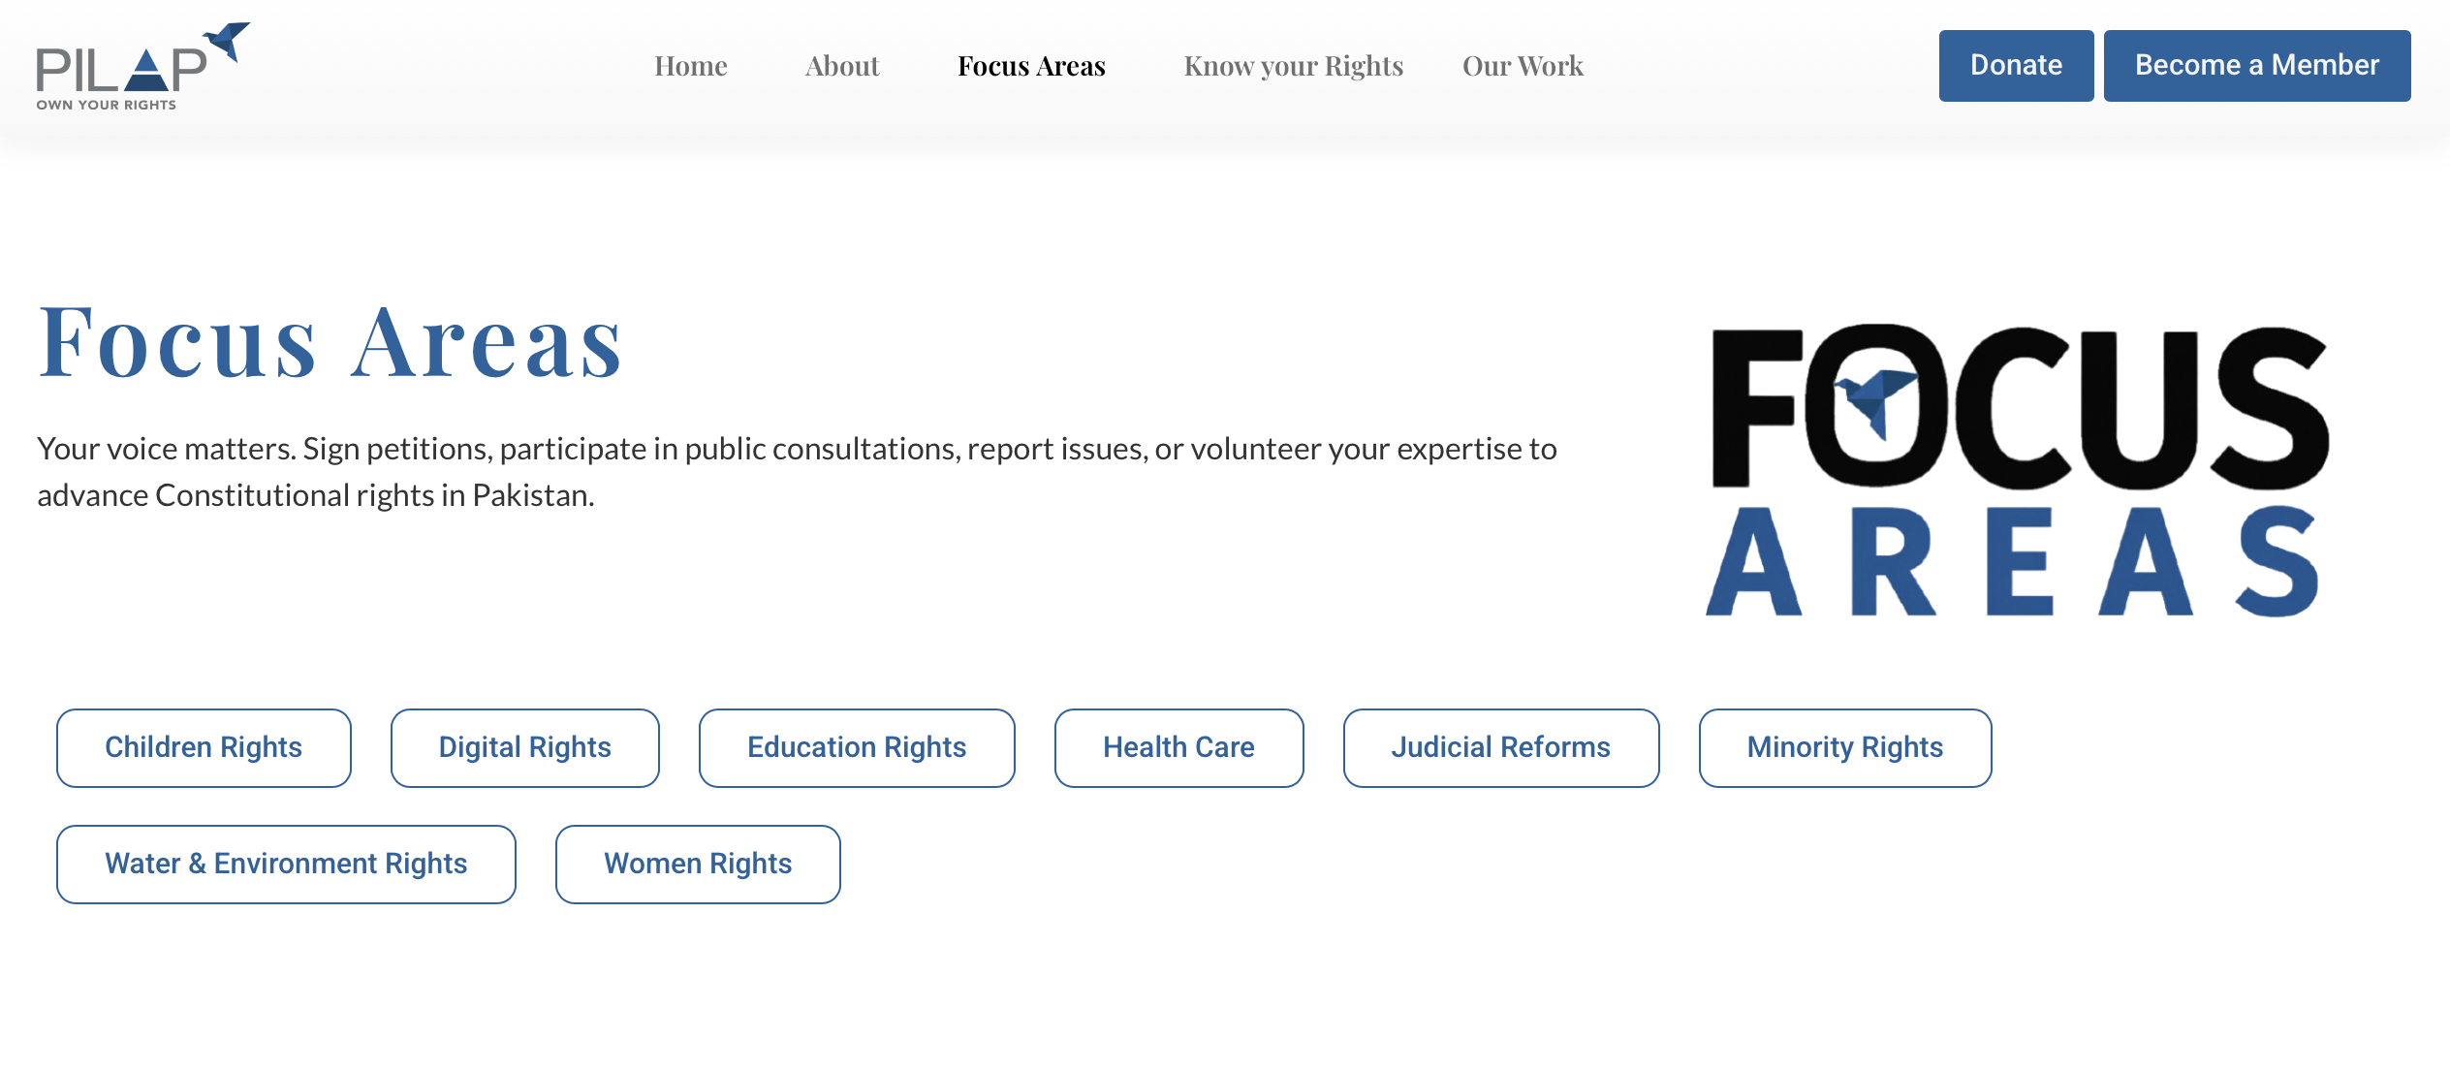

Slide 50
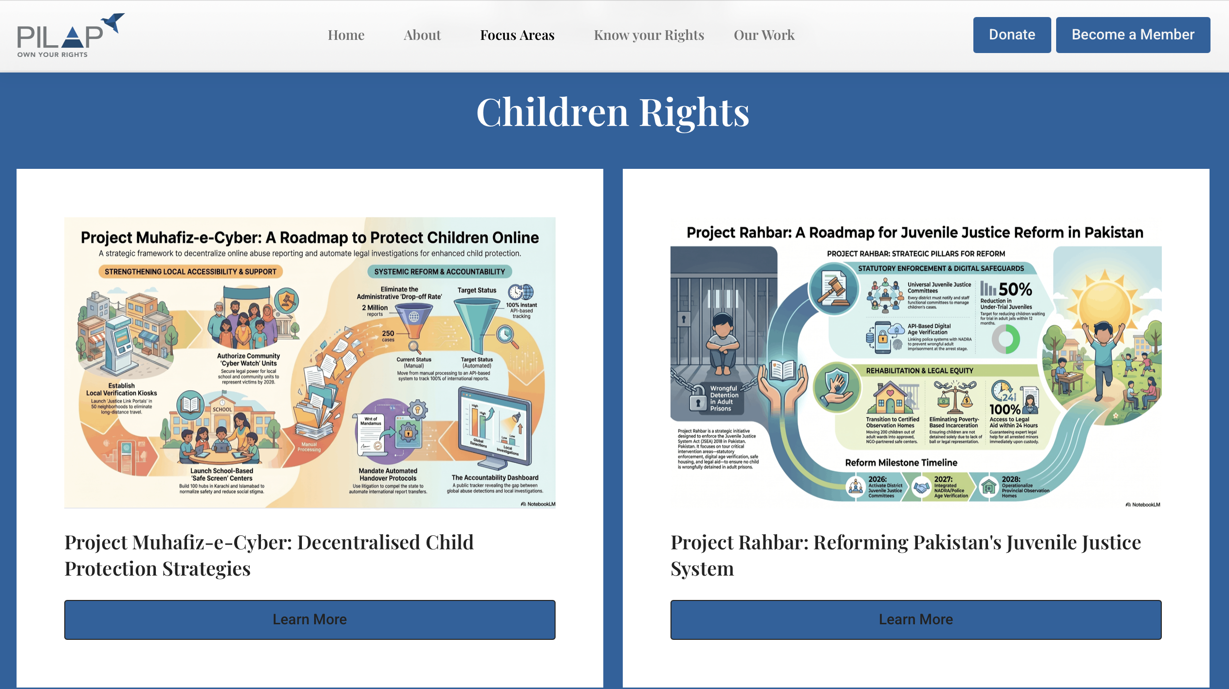

Slide 51


Slide 52
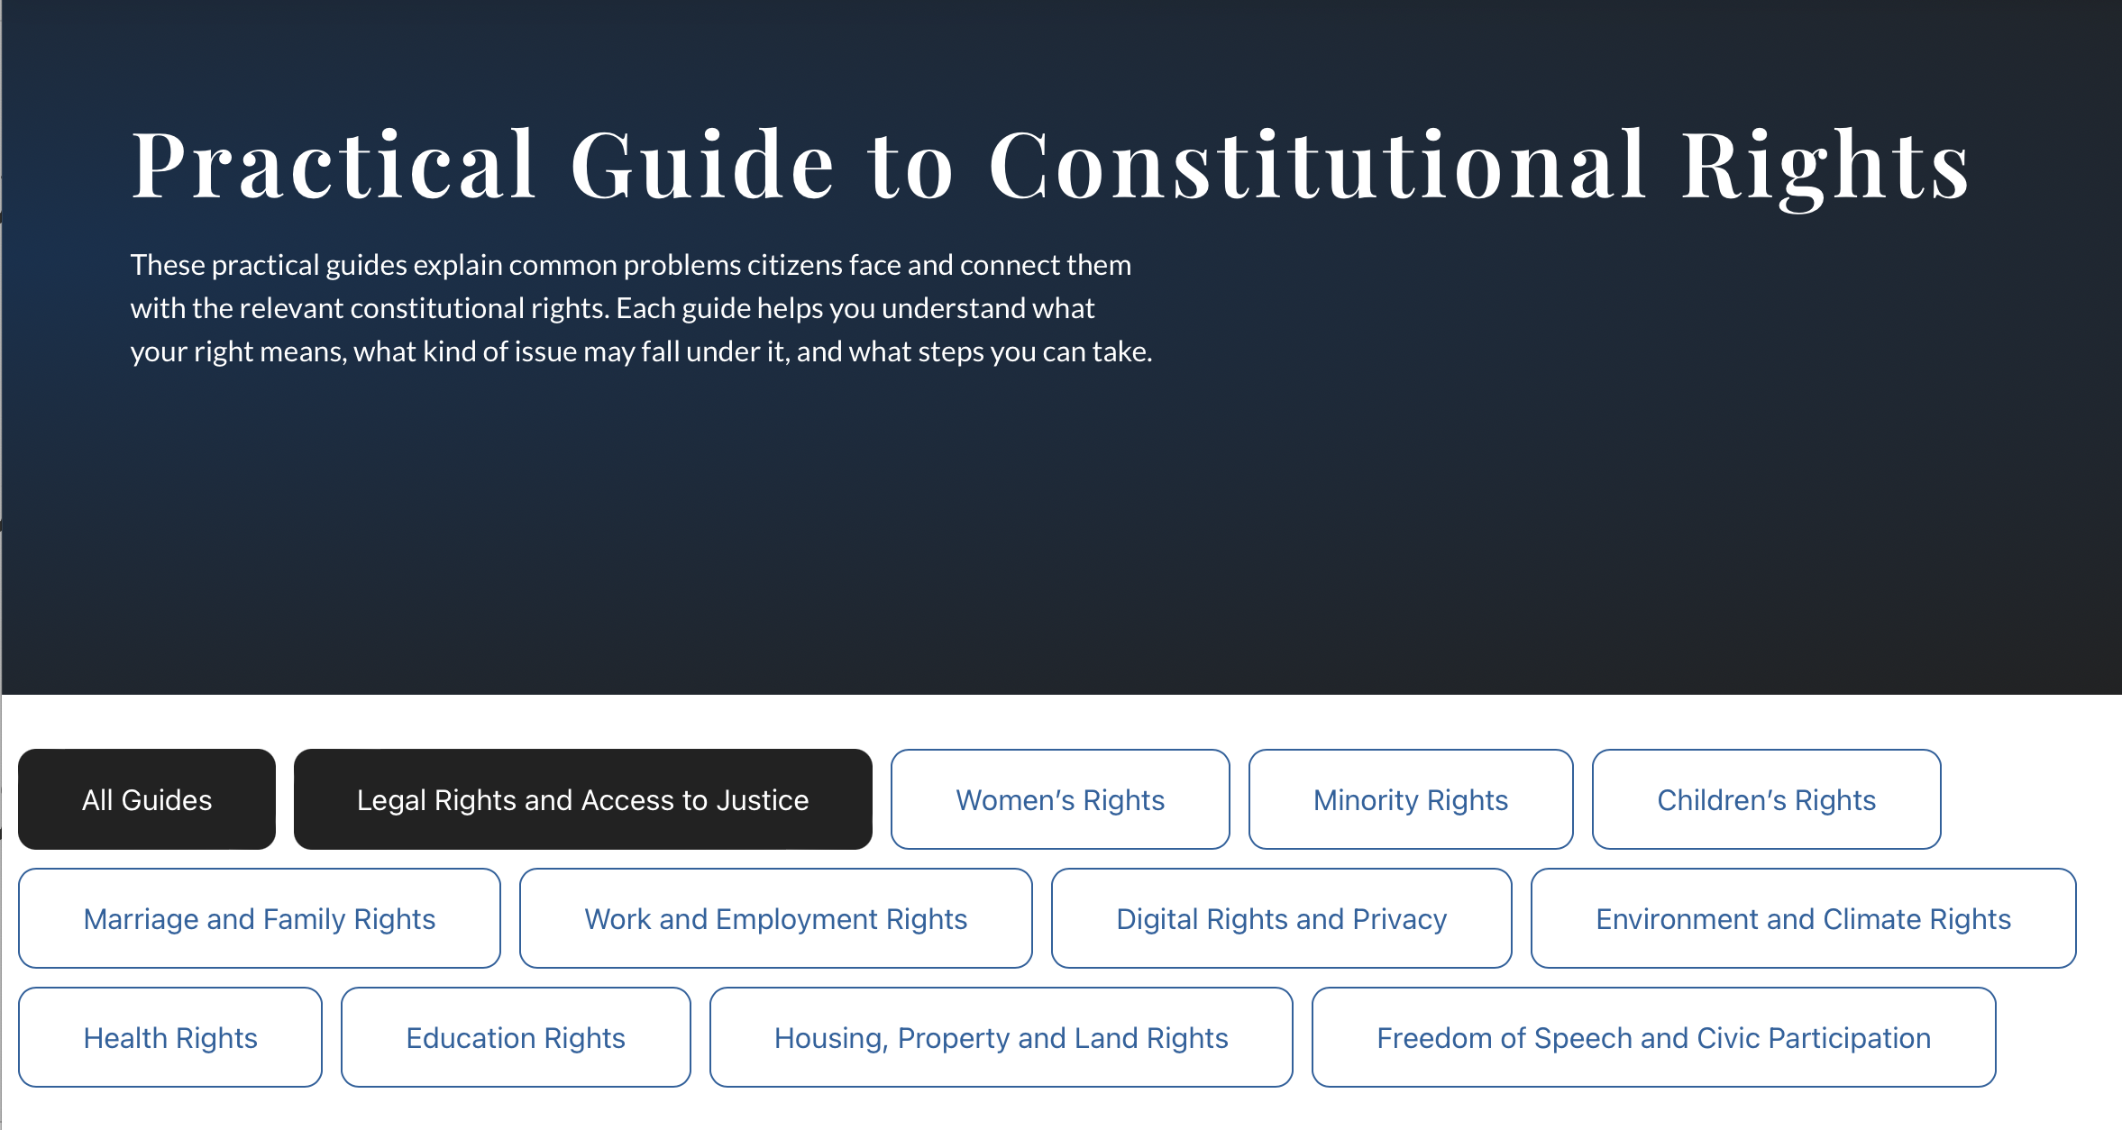

Slide 53


Slide 54
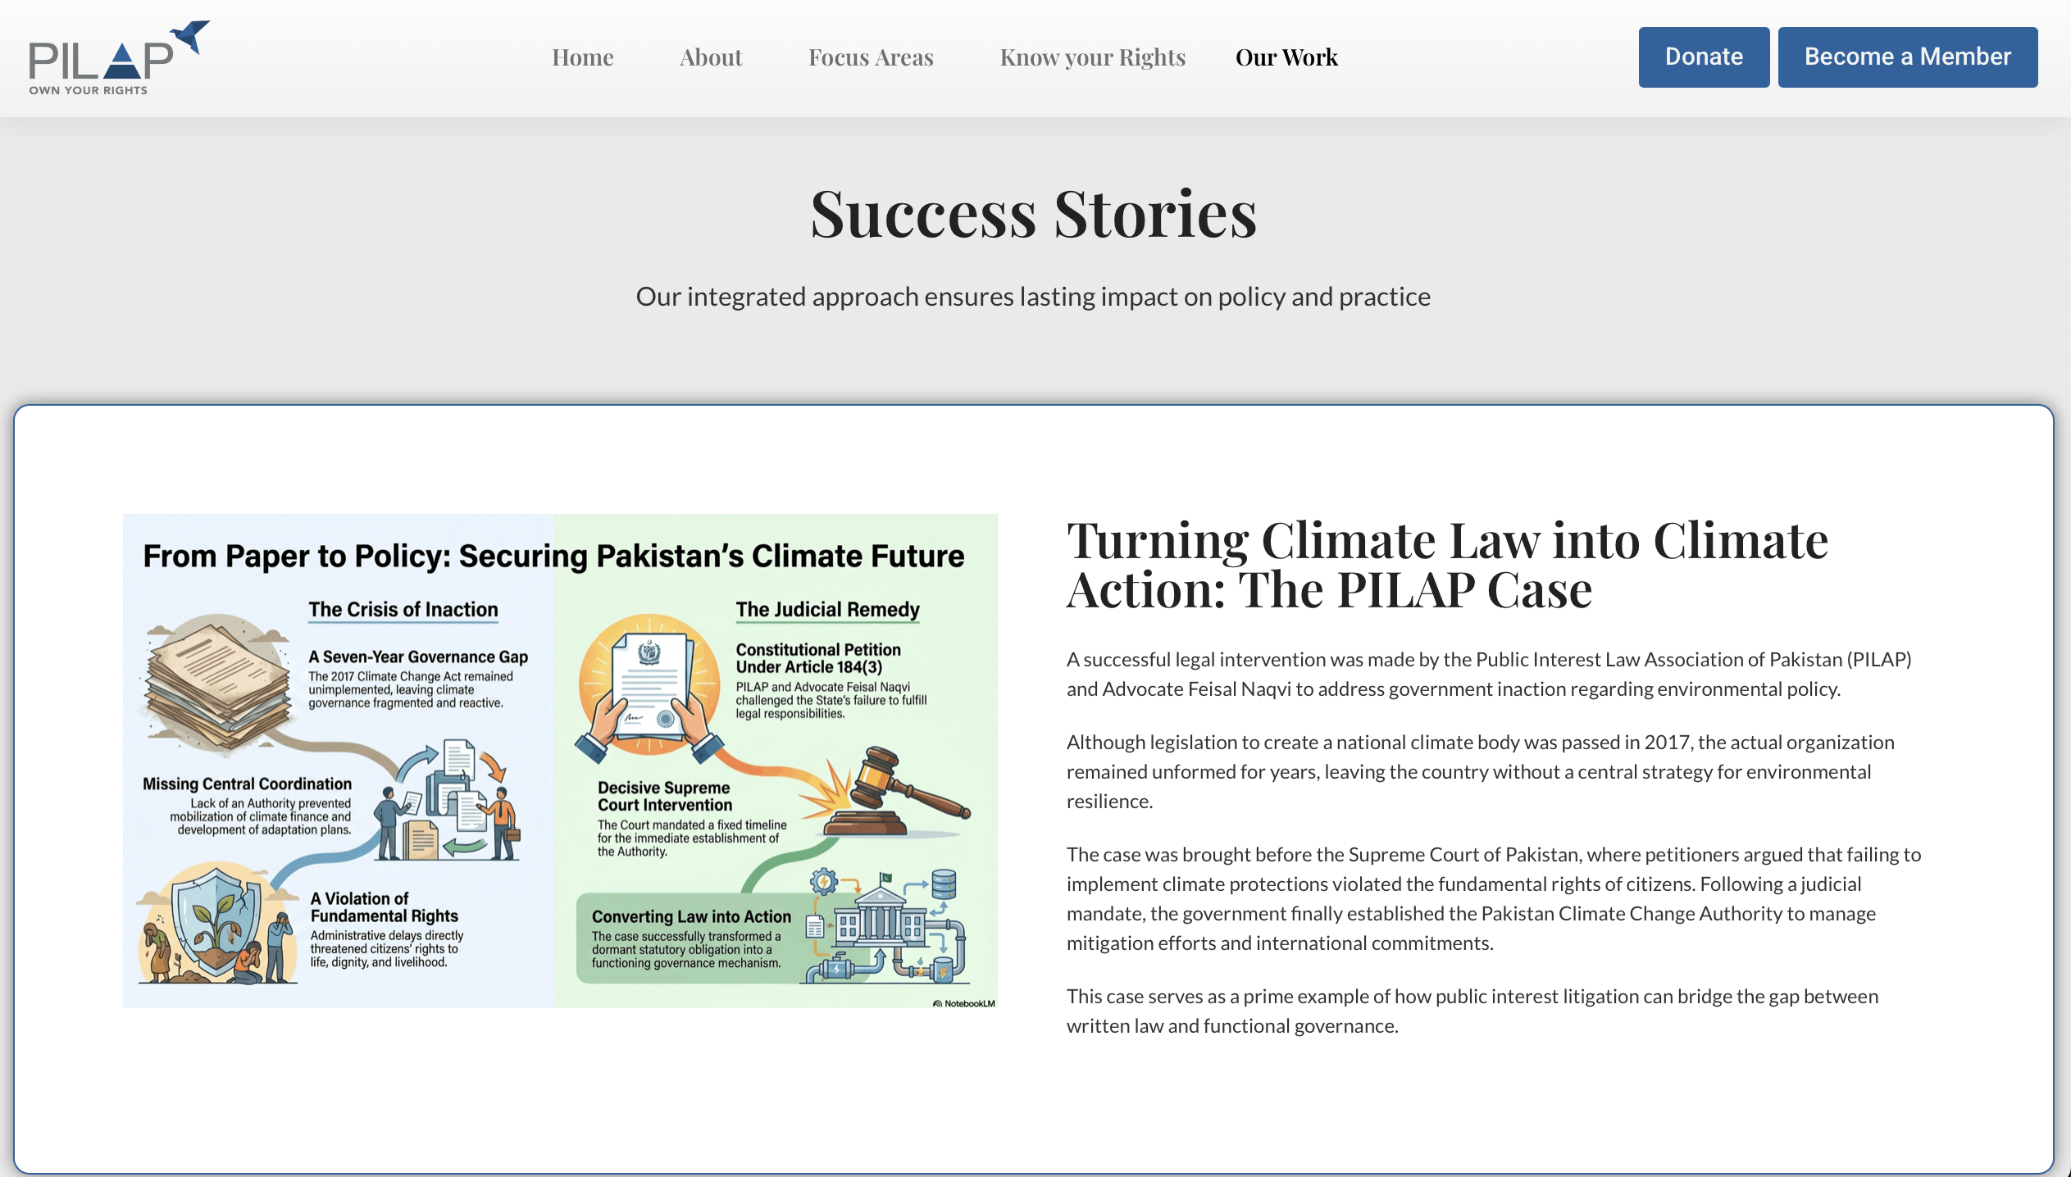

Slide 55
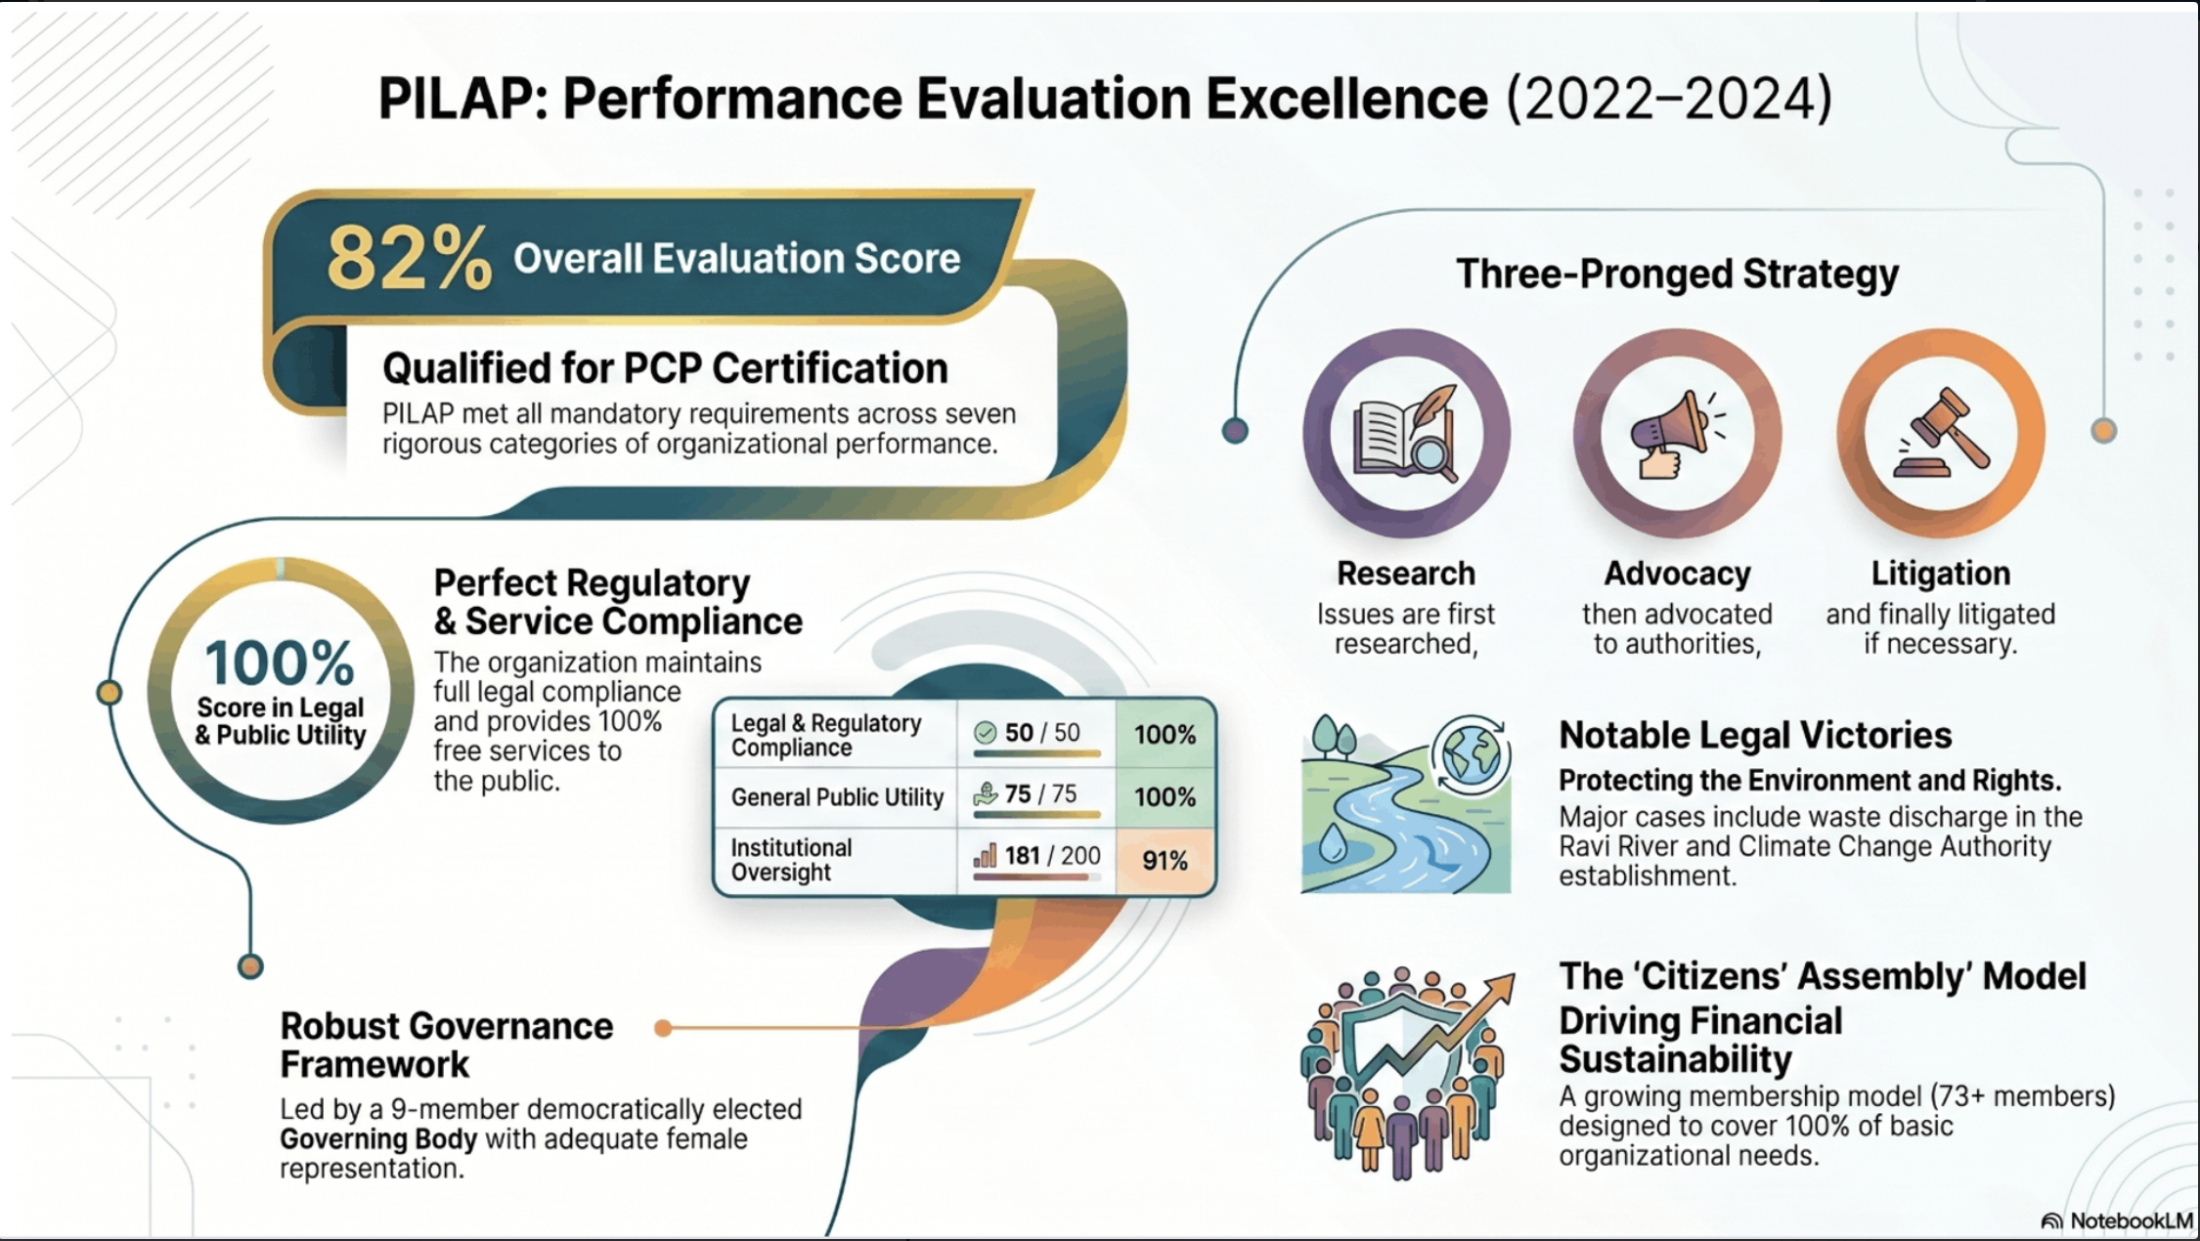


Slide 56

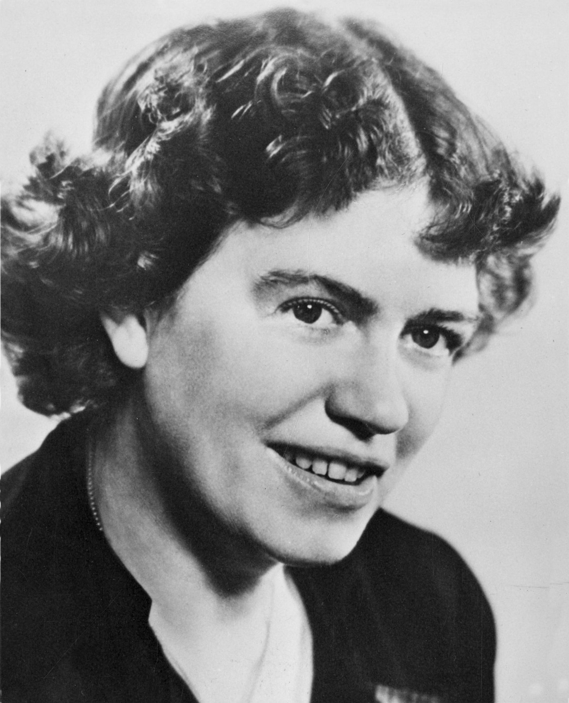
  "Never doubt that a small group of thoughtful, committed citizens can change the world; indeed, it is the only thing that ever has."
  Margaret Mead (1901 – 1978)
  American Cultural Anthropologist

Slide 57


Slide 58


Slide 59


Join PILAP and join the Civil Society platform
Membership options
Citizens’ Assembly
  Fee Rs 100,000 per year
  Influencing PILAP Strategies
Associate Member
  Fee Rs 20,000 per year
Student Membership
  Free Membership
  Engage in PILAP Activities

Slide 60

PLEASE
DO

Slide 61


